Slide 1
Aras Training Module 4: Engineering Change Notices
Aras training bookmark:
http://arastest.seaspan.com/innovatortest
Aras production bookmark:
http://aras.seaspan.com/innovatorprod
Notes:
Welcome to ECN training!

Slide 2

Customized Training Modules
Depending on your role and involvement with functional design documents you will need 2 or more of the following:
Aras 101 – Introduction to Aras
Problem Reports (PR)
Engineering Change Requests (ECR)
Engineering Change Notices (ECN)
Comment and Review
Training Dates will be available in Seaspan Learn
Discussion at the end of today’s session will help you identify what you need.
x
x
Notes:
Read Slide
You’ve likely done the PR & ECR training at this time. It is mandatory that you’ve completed 101

Slide 3


Getting Started with Aras
Aras works in Internet Explorer 10
Log into Aras using your Seaspan User ID
Bookmark Aras for easy access
Aras training bookmark:
http://arastest.seaspan.com/innovatortest
Aras production bookmark:
http://aras.seaspan.com/innovatorprod
Note
Contact IT if your browser is not set to IE 10 or if you are unsure
When accessing Aras from external sources, connect to VPN first.
- In near future, a secure server website will be provided and VPN will not be needed.
Notes:
I don’t think we need to review this slide anymore, but please note that there is a training server and production server. You will be notified by email when we go live to start using the production server

Slide 4

Today’s Agenda
Engineering Change Notice & Documents
Workflows
Lifecycles
Affected Items
Technical Training & FAQ
Hands-on exercises

Slide 5
Learning Objectives
Understanding the Engineering Change Notice (ECN) Workflow and Lifecycle
Creating and working with an ECN
Reviewing ECN properties
Notes:
by the end of this training, you will have created an ECN with affected items (documents)

Slide 6
Managing Changes with Aras
We report, track, and manage changes to the product throughout its lifecycle. The Aras change management forms include:
Problem Report (PR)
Identification of a technical problem/issue, and verification that it is a legitimate problem
Engineering Change Request (ECR)
Decision to implement the change may involve customer, costing, schedule, CCP.
The end result is ECRs approved or disapproved
Engineering Change Notice (ECN)
The actual updates to the engineering documentation
The end result is affected documents in the ECR are updated
Notes:
It is an engineering decision as to when to create the different products – Only CMDM will have the ability to create an ECN (generally, ECN is created based on the response of a ECR).

Slide 7
What is an ECN?
Engineering change notice (ECN) is a form that authorizes a change to a designated design (document)
ECNs are used to update technical items (documents) within Aras
An ECN must contain the following information:
Reason(s) for change
Details regarding what needs to be changed
List of documents affected by the change
Approval of the change
Notes:
ECN is used to manage the lifecycle of documents.
It releases new documents in Aras, updates existing released documents, and supersedes released documents.
In the following training, we will be creating an ECN and then adding affected documents to the ECN

Slide 8
Workflow – Create and Submit ECN
CM/DM
CM/DM
ECN Approver
Owner/SME
ECN Approver
CM/DM
Submit ECN
ECN Planning
Update Documents
Review Documents
Internal Approval
ECN Released
Start
Go
Submit
Complete
Complete
Approve
Release
Reject
Submit for external Approval
Reject
Release
Formal External Review
CM/DM team responsible for creating and submitting ECN
CM/DM
Notes:
First of all, we are going to review the ECN workflow. We will do a general review of it and get into the details.
General: ECNs are created, planned, affected documents are updated, the updates are approved and the documents are released
CM Team will initiate ECN. They are the only ones able to submit an ECN.
CMDM will require input from engineering to identify how many ECNs are needed to address one or many ECRs.
EXAMPLE: if an ECR requires an update to piping AND electrical, a decision needs to be made regarding how many ECNs are created.
One option is to add both electrical AND piping to the same ECN, but this requires both updates to be approved at the same time.
Alternatively, 1 ECN can be created for piping, and one for electrical. The decision is based upon who does the updates, how the updates are done and the schedule for the updates.

Slide 9
Workflow – ECN Planning
CM/DM
CM/DM
ECN Approver
Owner/SME
ECN Approver
CM/DM
Submit ECN
ECN Planning
Update Documents
Review Documents
Internal Approval
ECN Released
Start
Go
Submit
Complete
Complete
Approve
Release
Reject
Submit for external Approval
Running a “Check for Completeness” is required
**Checks whether Affected Documents fields have been entered correctly**
Reject
Release
ECN Approver reviews information and assigns an Owner/SME and confirms how the affected documents will be updated
The ECN owner will be responsible for performing the actual updates to the affected technical documents
***Cannot add/remove affected documents beyond this point***
Formal External Review
CM/DM
Notes:
ECN Planning Stage –
Assigns an Owner/SME to the ECN. To submit a vote and move to next stage of workflow, click ‘update activity’. Also need to edit effectivity date.
During ECN planning, documents to be added/deleted/changed are identified
IMPORTANT: Under Actions menu, run “Check For Completeness” whenever a document item is attached under Affected Items tab
Check for completeness – allows you to verify that the action fields (Add/Change/Delete) for Affected Document Items have been entered correctly

Slide 10
Workflow – Update Documents
CM/DM
CM/DM
ECN Approver
Owner/SME
ECN Approver
CM/DM
Submit ECN
ECN Planning
Update Documents
Review Documents
Internal Approval
ECN Released
Start
Go
Submit
Complete
Complete
Approve
Release
Reject
Submit for external Approval
Reject
Release
Formal External Review
Owner/SME updates the document(s) affected by the change specified in the ECN
CM/DM
Notes:
Update Documents stage – (between update documents & review documents is where multiple Comment & Review cycles occur – could be done 100 times – performed until all the related comments have been addressed and the approver says the document should be approved)
Owner/SME checks in-basket for ECN and updates the document(s) affected by the change specified in the ECN. Owner can edit the affected items or update the documents as he/she sees fit.
Go to document and click ‘edit’ doc. Can attach files/make changes
As we are transitioning to Aras, updated documents can initially be emailed to CMDM, and CMDM will perform the necessary updates as it is done today. This activity will eventually transition to engineers once engineers are confident with the process and in using Aras.

Slide 11
Workflow – Review Documents
CM/DM
CM/DM
ECN Approver
Owner/SME
ECN Approver
CM/DM
Submit ECN
ECN Planning
Update Documents
Review Documents
Internal Approval
ECN Released
Start
Go
Submit
Complete
Complete
Approve
Release
Reject
Submit for external Approval
Reject
Release
Formal External Review
ECN Approver reviews the documents and can approve or reject ECN
CM/DM
Notes:
Updated documents are submitted for review, and this may involve the comment & review process
During the review period, the ECN approver should verify that all comments and updates have been completed.
once confirmed, the ECN is approved
Please note that there is a field in the ECN form that indicates whether the updates should be submitted for external review.
Please make sure it is populated correctly, as it will impact CMDM activities at the “internal approval” workflow

Slide 12
Workflow – Internal Approval
CM/DM
CM/DM
ECN Approver
Owner/SME
ECN Approver
CM/DM
Submit ECN
ECN Planning
Update Documents
Review Documents
Internal Approval
ECN Released
Start
Go
Submit
Complete
Complete
Approve
Release
Reject
Submit for external Approval
Reject
Release
Formal External Review
CM/DM responsible for internal approval of affected documents
CM/DM determines if affected documents on ECN require formal external review. If it is required, ECN submitted for External Review. If not, document is released
CM/DM
Notes:
If external approval is required, the updates are sent for external review.
If external approval is not required, the document/ECN is set to released

Slide 13
Workflow – Formal External Review
CM/DM
CM/DM
ECN Approver
Owner/SME
ECN Approver
CM/DM
Submit ECN
ECN Planning
Update Documents
Review Documents
Internal Approval
ECN Released
Start
Go
Submit
Complete
Complete
Approve
Release
Reject
Submit for external Approval
Reject
Release
Formal External Review
Upon receipt of the comments back from Client, CM/DM will consult with the COG to validate whether the package has been approved or not, then release or reject the ECN accordingly
CM/DM
Notes:
If there are comments from the external reviewer, the document may require additional updates. In which case it is rejected.
Rejected ECN can go into the C&R loop again multiple times. ECN will have to be internally approved again before it is re-submitted to the customer.
If the external reviewer approves the form, it is set to released

Slide 14
Workflow – ECN Released
CM/DM
CM/DM
ECN Approver
Owner/SME
ECN Approver
CM/DM
Submit ECN
ECN Planning
Update Documents
Review Documents
Internal Approval
ECN Released
Go
Submit
Complete
Complete
Approve
Release
Reject
Submit for external Approval
Reject
Release
Formal External Review
ECN is released, so changes on affected documents are implemented. Workflow ends
CM/DM
Notes:
Once ECN is released, the workflow ends and the affected documents are impacted by the change.
All of the documents in the ECN will have to be approved/released at the same time.
Recommendation: 1 ECN per document, unless they are related and have to be approved at the same time.

Slide 15
ECN Lifecycle & Workflow
Lifecycle | New | In Planning | In Work | In Review | Internally Approved | Submitted | Released
Workflow | Submit ECN | ECN Planning | Update Docs | Review Docs | Internal Approval | Formal External Review | ECN Released
ECN Workflow activities
corresponding to various stages of
ECN Life Cycle

Slide 16
Exercise 1: ECN Practice
Create an ECN
Fill in the following information on the ECN:
Title (put your name in the title)
Project
Owner/SME (your Logon - CMx)
ECN Approver (Your Logon - CMx)
Priority For Implementation
Select SAVE (the floppy disk) and leave ECN open
Record your system assigned ECN Number
Description
Schedule And Implementation Instructions
Reviewer And Audit Comments
Notes:
I will continue to explain the properties in the next slides as you fill them out
Write down the ECN number for the ECN you have created.

Slide 17
Creating a New ECN
CM/DM
CM/DM
ECN Approver
Owner/SME
ECN Approver
CM/DM
Submit ECN
ECN Planning
Update Documents
Review Documents
Internal Approval
ECN Released
Start
Go
Submit
Complete
Complete
Approve
Release
Submit for external Approval
Reject
Reject
Release
Formal External Review
CM/DM
CMDM will require input from engineering (ECN owner) to identify how many ECNs are needed to address one or many ECRs

Slide 18
Filling in a New ECN
ECN forms have properties that need to be filled in by the Creator & Owner of the ECR
Property Name | Description | Populated by Whom & When
ECN # | Assigned automatically by the server, next number, unique | System Generated
Title | Descriptive title of the ECN (assists in searching) | Creator of the ECN
Project | VSY Project | Creator of the ECN
Owner/SME | The Owner of the ECN, this identity will receive workflow assignments throughout this ECN workflow. Responsible for updating the document(s) subject to change specified in the ECN | Creator of the ECN but can be validated during ECN Planning
ECN Approver | Reviews ECN and assigns Owner. Also responsible for approving or rejecting ECN | Creator of the ECN

Slide 19
Filling in a New ECN
Property Name | Description | Populated by Whom & When
Priority for Implementation | Based on the information that the CM Team was provided by the SME, | Creator of the ECN
Effective Date | The effective date of the ECN (today or future) | ECN Manager, during ECN Planning
Status | Lifecycle State of the ECN, controlled by Aras ECN workflow | System Generated
Customer Approval | These are VSY properties to track if the ECN requires Customer Approval., and the date which the customer approved can also be recorded | ECN Manager, during ECN Audit
Description | Description of the ECN | Creator of the ECN
Schedule & Implementation Instructions | VSY CM enters information regarding any schedule and implementation instructions. | ECN Manager, during ECN Planning

Slide 20
Filling in a New ECN
Property Name | Description | Populated by Whom & When
Reviewer and Audit Comments | CM enters the reviewer and audit comments. | ECN Manager, during ECN Audit
Security Settings | NOTE: No IP, or Commercially Sensitive data should be put in Aras during Phase 1, as access to it will note be controlled. This includes costing information. | Not used at this time
Affected Items Tab | All affected items that are being processed on this ECN, need to be attached. | Creator of the ECN
ECRs | Any ECRs that exist that support the reason why this changes is being implemented should be associated to this ECN as supporting information | Creator of the ECN
Files | Any files that support this ECN should be attached. NOTE: FILES that should exist as Documents | Creator of the ECN

Slide 21

ECR – Attaching ECR to an ECN
ECRs Tab:
Links the ECN to ECRs that are affected
1
2
Step 1 – Select “ECRs” in the relationship tabs
Step 2 – Click on “New Relationship” button to add a blank row
Notes:
You can attach ECRs to an ECN
Select the ECR section
Select New Relationship button

Slide 22
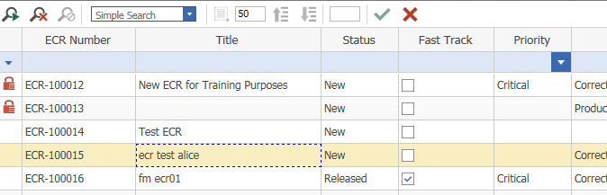
ECR – Attaching ECR to an ECN Continued..
3
5
4
Step 3 - Search for the ECR
Step 4 - Select the ECR you want to attach
Step 5 - Confirm using the Green Checkbox
Notes:
Search dialog appears after pressing New Relationship button
Search for the PR using the Search dialog box that appears
Select the desired PR by either double-dicking or single-click and select green checkbox. Save your ECR.

Slide 23

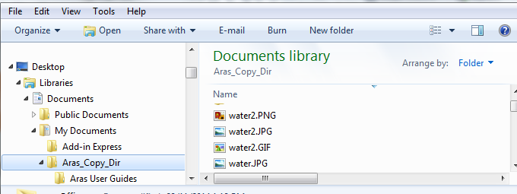
Files - Attaching Files to an ECN
Files Tab:
Upload associated files to the ECN
In the Files section select New Relationship button
Select the file you need from your drive, and Save/ Save,Unlock & Close the ECR
Notes:
When you want to attach files from your computer to an ECR
Go to the Files tab in the relationships section
Select New Relationship button
Select file to be attached and checked into Aras Vault. Select the File from Windows Explorer. Save or Save, Unlock & Close the ECR Item.
Repeat 1-3 to attach more files this way

Slide 24
Exercise 2: ECN Practice
Add ECRs and Files to the ECN
Refer to #11 & 13 in your Quick Reference sheets
Select SAVE (the floppy disk) and leave ECN open

Slide 25
ECN Planning: Attaching Affected Items
CM/DM
CM/DM
ECN Approver
Owner/SME
ECN Approver
CM/DM
Submit ECN
ECN Planning
Update Documents
Review Documents
Internal Approval
ECN Released
Start
Go
Submit
Complete
Complete
Approve
Release
Submit for external Approval
Reject
Reject
Release
Formal External Review
CM/DM
During ECN planning, documents to be added/deleted/changed are identified
***Cannot add/remove affected documents beyond this point***

Slide 26
Documents and ECNs
Submitted
Aras PLM
Aras PLM
Aras PLM
Aras PLM
Aras PLM
Aras PLM
Aras PLM
Preliminary
In Review
Internally Approved
Released
NOTE: Documents DO NOT have their own workflow.
A document must be an affected item on an ECN in order for its Lifecycle to be PROMOTED from one life cycle state to another
Notes:
Now that we have created a draft ECN, we have to understand how to attach affected items to the ECN. Before we do this, we are going to review the document life cycle.
General: When a document is created/updated, the document will be preliminary while the updates are being performed. It will then go into a review process, where it may be approved or rejected. Once internally approved, it may be submitted for external review. But the end result is that it is released.
If the rev A of a document has been released, rev A will remain the released revision until rev B is released.
An ECN is used to implement a change to the status of a document.
An ECN is the only way to change the status of a document from released to superseded and from preliminary to released.

Slide 27
Exercise 3: Create a New Document
Go to the Documents TOC
Create a new document (Select the Green Plus button)
Populate the Title (with your name)
Populate the Doc No and Doc Rev
Using the Files Tab, attach the blank word file from your desktop
Save,Unlock & Close (Green Checkmark)
Record your system assigned Document Number
Notes:
Record your system assigned Document Number

Slide 28
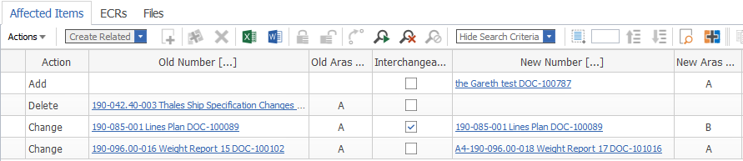
Affected Items - 4 Ways To Affect A Document
Affected Items Tab capabilities:
New Preliminary Documents can be released (Add)
Released document can be superseded (Delete)
Released documents can be up-revved (Change-Interchangeable)
Released documents can be replaced (Change- Non interchangeable)
Notes:
Under ‘Actions’, there are 3 Actions one can perform – add, change, delete.
1 Add allows you to deposit a preliminary document to Aras Vault and update the status of the document to released.
2 Delete allows you to render a released document on Aras Vault obsolete – so no longer in use.
3 Change allows you to up-rev a released document
4 Is a combination of 1 and 2 where a new document is released and an existing document is superseded

Slide 29
Document Lifecycle and ECNs
 | ECN Workflow & Lifecycle
ECN Lifecycle | New | In Planning | In Work | In Review | Internally Approved | Submitted | Released
ECN Workflow | Submit ECN | ECN Planning | Update Docs | Review Docs | Internal Approval | Formal External Review | ECN Released
Change Action Options | Document Lifecycle
ADD | Preliminary | Preliminary | Preliminary | In Review | Internally Approved | Submitted | Released
CHANGE Interchangeable | Released | Released | Preliminary | In Review | Internally Approved | Submitted | Released
CHANGE Non-Interchangeable Old # | Released | Released | In Change | In Change | In Change | In Change | Superseded
CHANGE Non-Interchangeable New # | Preliminary | Preliminary | Preliminary | In Review | Internally Approved | Submitted | Released
DELETE | Released | Released | In Change | In Change | In Change | In Change | Superseded
Comment and Review process is performed during these states/activities
Notes:
This is a another copy of the document lifecycle with a reference grid for the ECN Workflow and Lifecycle
Basically in an ECN you can Add Change and Delete documents, in the table you can see the status of the ECN and the Affected Document
Once again - This is to illustrate where the Comment and Review Process occurs
Enough of the overview ….

Slide 30
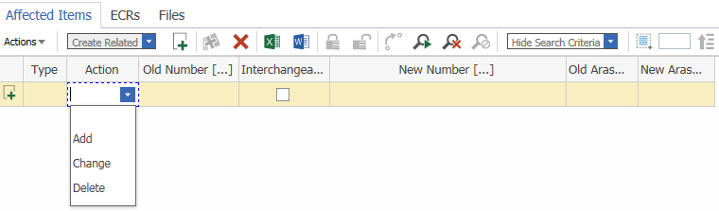
Affected Items – Attaching a Document Item to an ECN
1
2
3
Affected Items:
Links the ECN to document(s) that are affected
Step 1 – Find Affected Items in relationship tabs
Step 2 - In the Affected items section select New Relationship button
Step 3 - Select cell under Action column and choose the action type
Notes:
This is the ECR Relationships tab
Additional Notes about the Affected Items section:
Old Number and Old Aras Revision Column: The item/document that is being Changed. Not editable when Action = Add for new part/document release.
Interchangeable Column : Denotes a re-identification intent. New revision will be created. Only needed when Action = Change.
New Number and New Aras Revision columns: The proposed new number/revision. If interchangeable is set, will be filled in by Innovator, o/w CM Team will enter new Document Number.

Slide 31
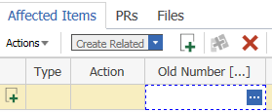
Affected Items - Drop Down Options
In relationship tabs, the search button often appears in cells under column titles with […] appended

Slide 32

Affected Items Add Document
1
2
ADD = items/documents that are Preliminary or new items to Aras
New Number in ADD = Preliminary Item, never been released
Step 1 – Select ADD under Action Column
Step 2 – Click on blank cell under New Number […], select to search for & link to a PRELIMINARY item

Slide 33

Affected Items Change Document – Interchangeable
1
2
Interchangeable = Making changes to an existing drawing, and WILL NOT BE REPLACING it with a different drawing – Creates a new revision of released document
Step 1 – Select CHANGE under Action Column
Step 2 – Click on blank cell under Old Number […], select to search for & link to a RELEASED item

Slide 34

Affected Items Change Document - NON-Interchangeable
1
2
3
Non-Interchangeable = Making changes to an existing drawing by REPLACING it with a different drawing – Supersedes Old document with New document
Step 1 – Select CHANGE under Action Column
Step 2 – Click on blank cell under Old Number […], select to search for & link to a PREVIOUSLY RELEASED item
Step 3 – Under New Number […], select to search for & link to a new PRELIMINARY, never been released item

Slide 35

Affected Items Delete Document
1
2
DELETE = items that you are removing from use
Step 1 – Select DELETE under Action Column
Step 2 – Click on blank cell under Old Number […], select to search for & link to a PREVIOUSLY RELEASED item

Slide 36
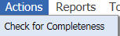
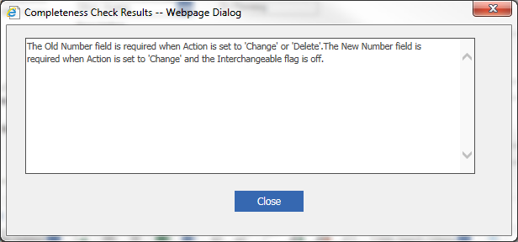
Affected Items Running Check for Completeness
Whenever a document item has been attached to Affected Items, run the “Check for Completeness” test under Actions menu to check for errors
***DO NOT add/remove affected documents beyond the “ECN Planning” activity***

Slide 37
Exercise 4: Attaching An Affected Item to the ECN and submitting the ECN
Locate your ECN in your in basket
Edit The ECN (right click > Edit ECN)
Add the document you created to the Affected Items
Refer to 10.1-10.5 in your Quick Reference Sheets
Locate your ECN in your InBasket – “Submit ECN”
Update the workflow activity and Submit the ECN

Slide 38
Update Documents: Making Changes to Documents Based on Review Comments
CM/DM
CM/DM
ECN Approver
Owner/SME
ECN Approver
CM/DM
Submit ECN
ECN Planning
Update Documents
Review Documents
Internal Approval
ECN Released
Start
Go
Submit
Complete
Complete
Approve
Release
Submit for external Approval
Reject
Reject
Release
Formal External Review
CM/DM
Where multiple Comment & Review cycles are performed until all the related comments have been addressed, and the documents are approved by the ECN Approver

Slide 39
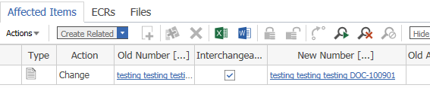
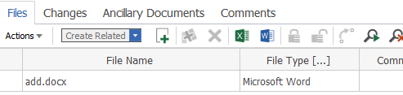
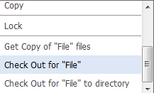
Affected Items Interchangeable – Checking-out File for Updating
During the “Update Document” workflow activity, Aras automatically generates a New Number for the interchangeable item
ECN
Step 1 - Click on the New Doc link to open Document item
1
Step 2 - In the Files tab of the Document Item, find the attached file needing update
Document
2
Step 3 - Right click & select Check Out for “File”
Step 4 - Find Checked-Out file in your Working Directory
3
Notes:
Working directory folder can be set under
Tools > Preferences > Change Working Directory…
OR you can select “Check Out for File to Directory” and choose the desired folder

Slide 40
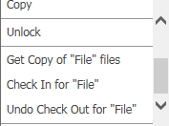
Affected Items Interchangeable – Checking-in File after Editing
After editing & saving the checked-out file opened from your working directory, this demonstrates how to check the file back into Aras…
Document
Step 1 - Right-click on the
locked/checked-out item
1
Step 2 - Select Check In for “File”
2
Step 3 - SAVE UNLOCK & CLOSE!

Slide 41
Review Documents: Review Updated Documents
CM/DM
CM/DM
ECN Approver
Owner/SME
ECN Approver
CM/DM
Submit ECN
ECN Planning
Update Documents
Review Documents
Internal Approval
ECN Released
Start
Go
Submit
Complete
Complete
Approve
Release
Submit for external Approval
Reject
Reject
Release
Formal External Review
CM/DM
Updated documents submitted for review, and may involve the comment & review process. Verify that all comments and updates have been completed. Indicate whether the updates should be submitted for external review.
Notes:
Exercise note:
Locate your ECN in your in-basket –
ECN Planning (during this stage, details of the updated are identified)
Edit The ECN (right click Edit ECN) –
this step is normally performed by CM with the support of Engineering (it may be assigned to Engineering)
Enter instructions into the “Schedule and Implementation Instructions” field (i.e. implement asap)
“Updated document” this would be performed by the engineer. In this case we are creating a new document.
“Review Documents” . This task is normally performed by a manager and upon completion of the review, the Manager may approve or reject the updates
“Internally Approve” . This task is normally performed by CM , the options are to submit to external for review or Release
Locate the document you have released

Slide 42
In Closing…
We have covered:
Workflow and Lifecycle of the Engineering Change Notice and Documents
Created , Updated and Attached items
Notes:
Thank you for being a part of the training session.

Slide 43

Questions?

